Slide 1
Deploying Open5g applications with continuous integration
PROJECT GUIDE: GROUP MEMBERS:
Debobroto Das Robin, Akhil Reddy Nalla (811172556)
Divya Sri Karingula(811172271)
Professor Ishita Patel (811164714) Khushbu Brahmbhatt (811127760)

Slide 2
Introduction
Open5g, Ueransim
This Open5g can be used to configure your own NR/LTE network. If gNB/eNB and USIM are available, you can build a private network using Open5GS.
Open5GS implemented 5GC and EPC using C-language and WebUI is provided for testing purposes and is implemented in Node.JS and React.
Ueransim is an open source 5G UE and 5G RAN (gNodeB) implementation.
System is considered as 5Gmobile phone and a base station.
Contains 3 main interface: User interface, Control interface and radio interface.

Slide 3
Problem Statement & Solution
Problem : Open5g Application developers can repeatedly build, test, and deploy newer versions of their applications, no matter where they are running and without any focus on Provisioning, Deploying Updating, Upgrading, availability & scalability
Solution : The main goal of this project is to create a platform to maintain Continuous integration , Continuous deployment and continuous testing for an Open5g system over cloud

Slide 4
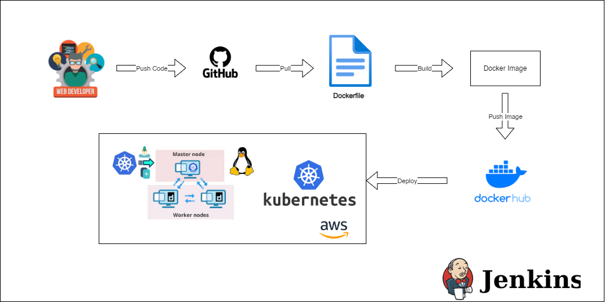
Planned System Architecture

Slide 5
Tools used
GitHub Code Repo
AWS Service
Docker Engine
Docker Hub Registry
Jenkins
Cadvisor
Grafana
Prometheus

Slide 6
Milestone 1
In previous we have discussed how the developer will create a branch to push their code in our repository.
Set up Ec2 instances
Set up Ubuntu machines
Set up Docker Engine
Set Jenkins instance
Creating a docker script and downloading the components from GitHub.

Slide 7
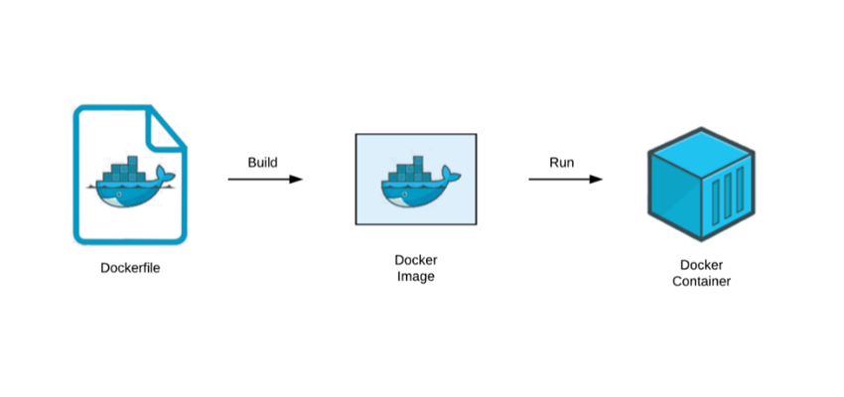
Milestone 2
In this project we will clone the code and write Docker files, build Docker images and we are going to run in docker containers.
We are going to use Jenkins pipeline to do continues integration/ continues development (CI/CD) of open 5g applications.

Slide 8
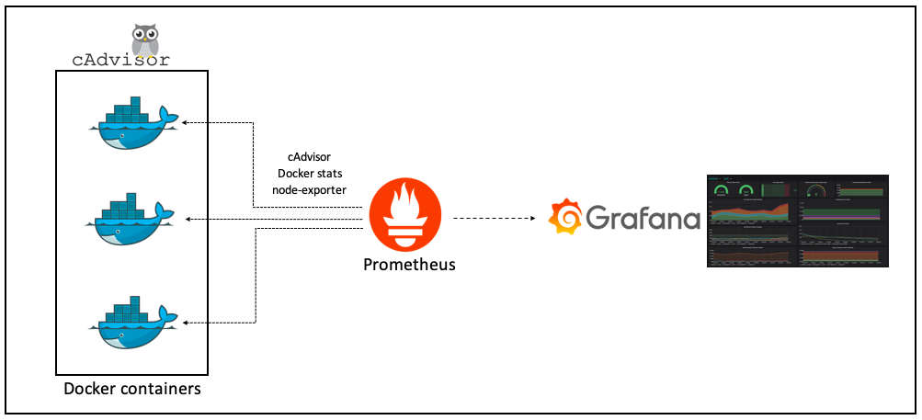
Milestone 3
In this Milestone we will be Automating the IP configuration for Open5gs components
Then using the Cadvisor for container monitoring
Prometheus collects data and metrics from different services and stores them according to a unique identifier

Slide 9
Milestone 4
Interaction between two components
Working on Documentation

Slide 10
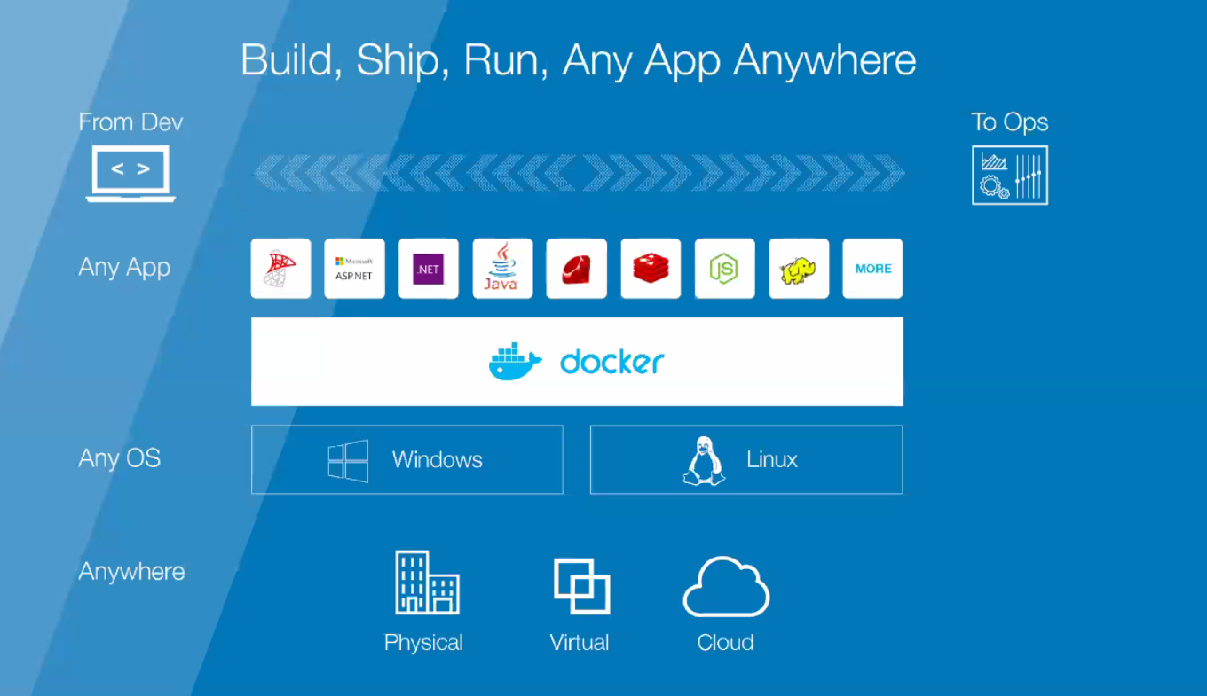
Docker
Write docker script for Docker files
Build Images
Run our images as a container
Use container for development
Configure CI/CD
Deploy and Monitoring our application

Slide 11
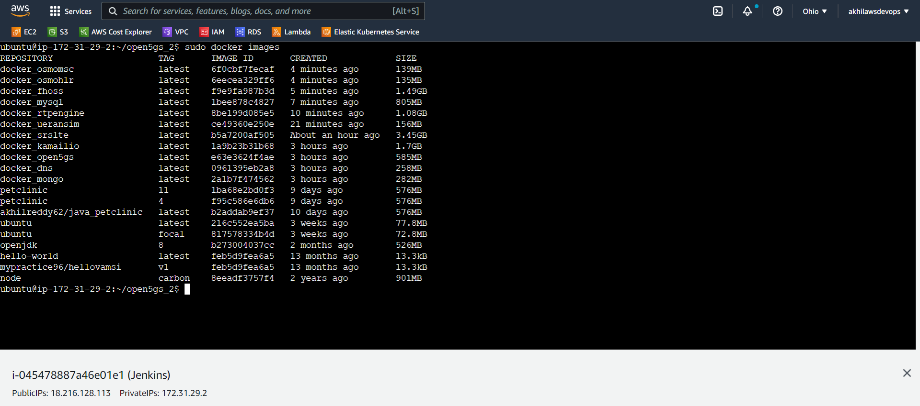
Docker Images

Slide 12
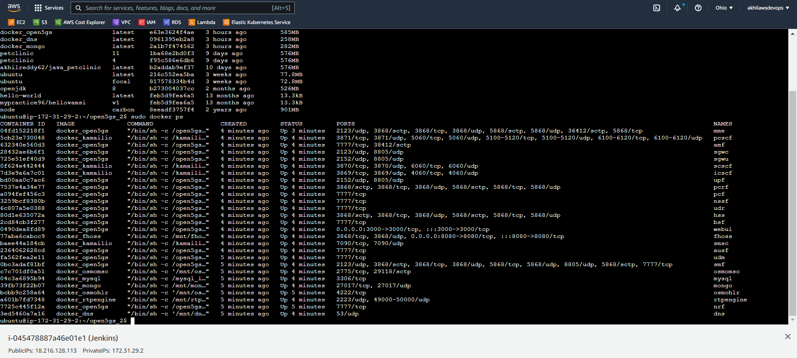
Docker Containers

Slide 13
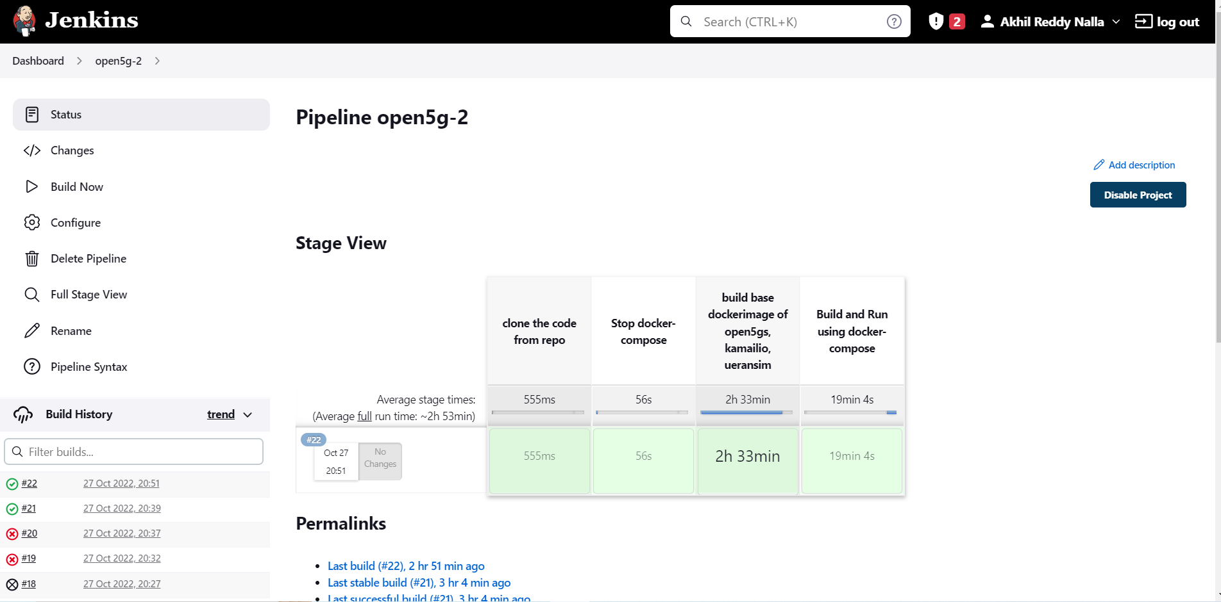
Jenkins

Slide 14
AWS Service
AWS Management console will provide multiple ways for navigating to individual service console
Amazon Elastic Compute Cloud (Amazon EC2) provides scalable computing capacity in the Amazon Web Services (AWS) Cloud.
Block storage It is a technology which stores the data and divides the data into blocks for fast access.
Security Policy for inbound value of ports access
IAM It is a web service which gives the secure access to aws resources

Slide 15
Prometheus
Open-source tool that provides monitoring and alerting for cloud-native systems
Time-series data, including a timestamp for each entry.
Key features –
Multidimensional Data Model, Pushing Time-series Data, Visualization

Slide 16
Grafana
A visualizing tool with a dashboard that provides a lot of options with graphs.
open-source tool to view the metrics, do the queries, and get alerts of logs being generated.
Charts and graphs are generated from data sources and available through a web browser.

Slide 17
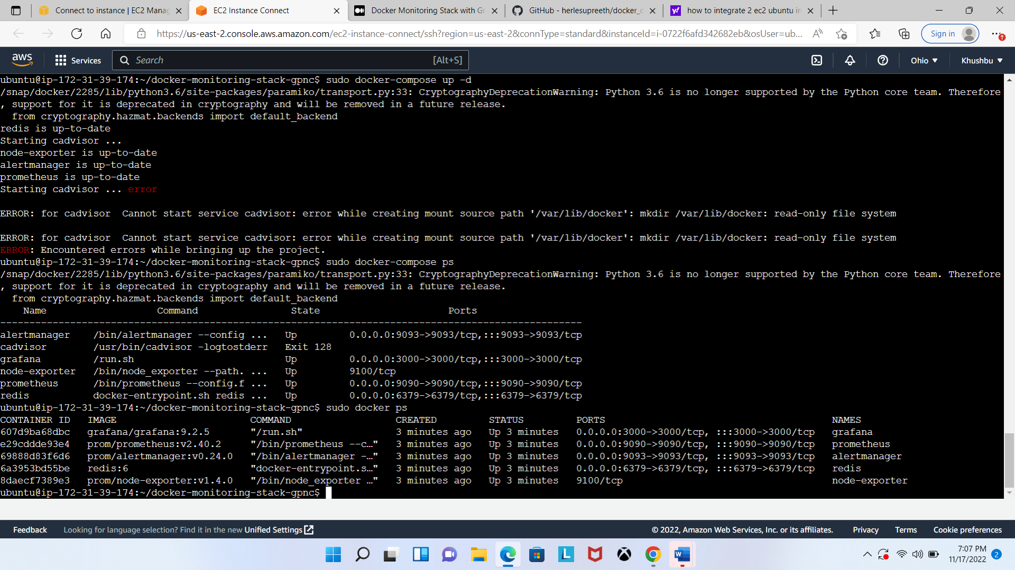
AWS Instance

Slide 18
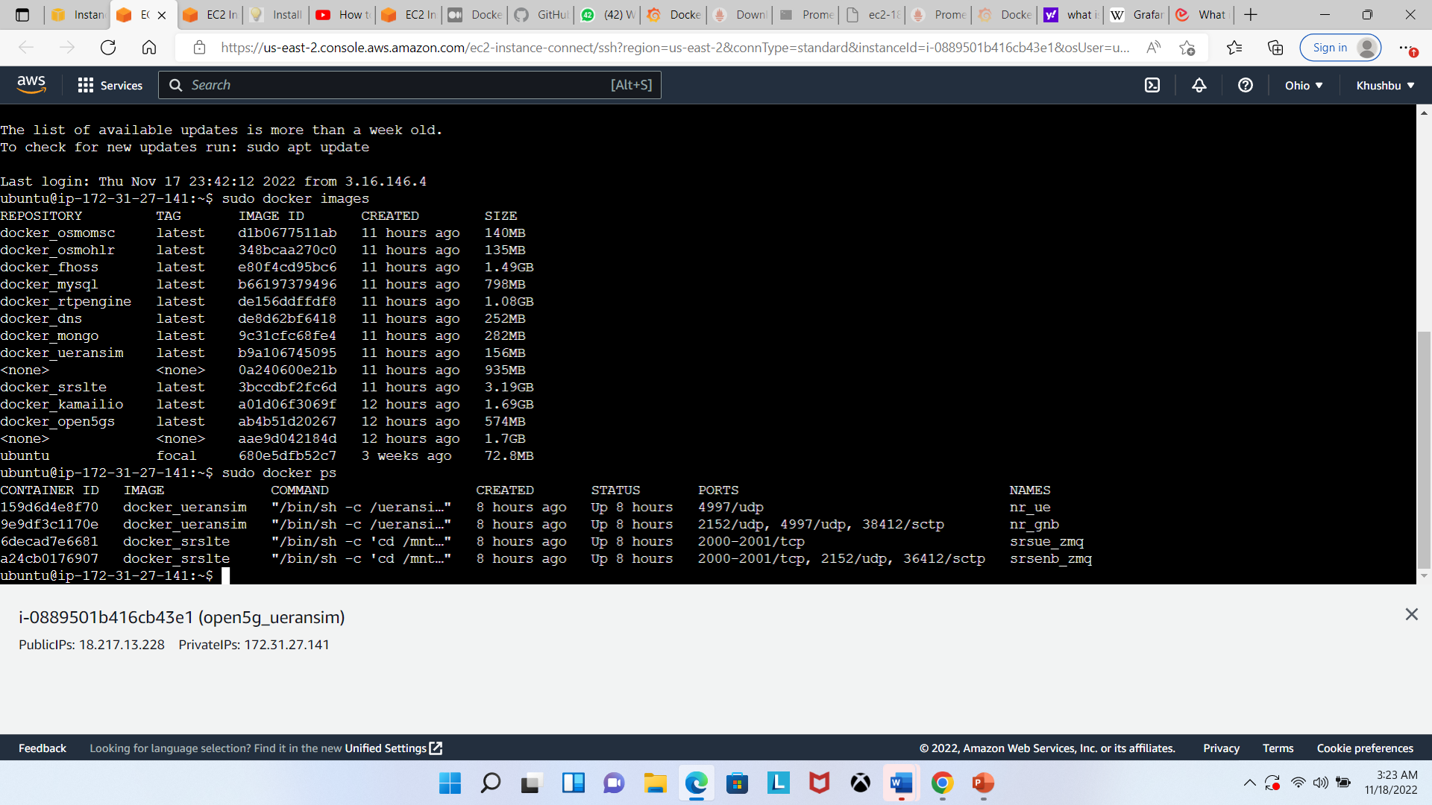
AWS Instance

Slide 19
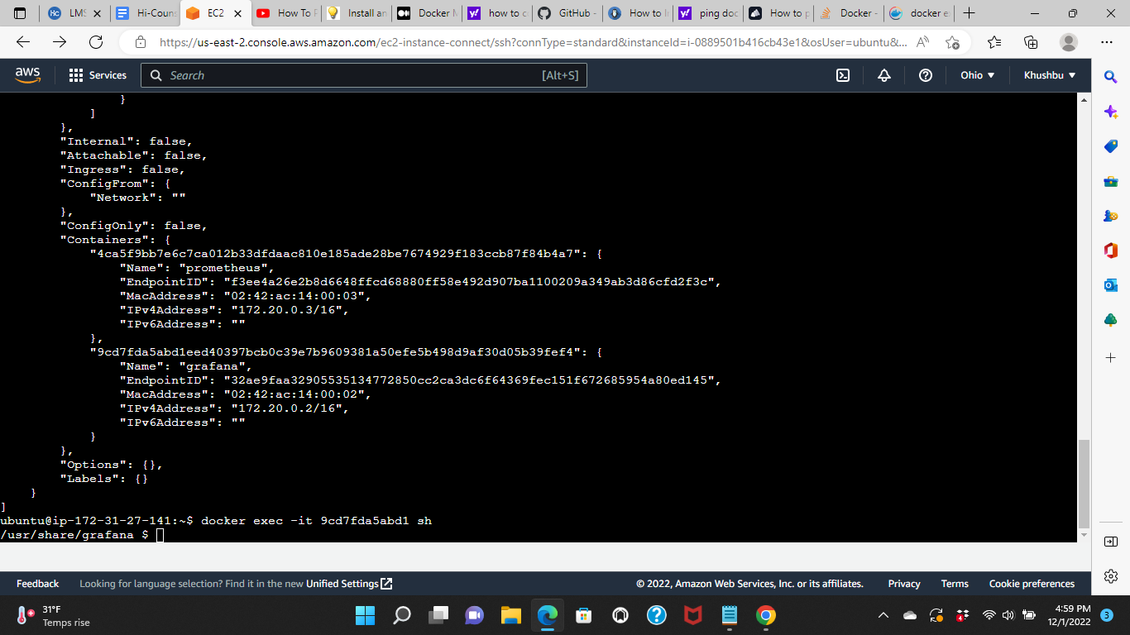
Interaction

Slide 20
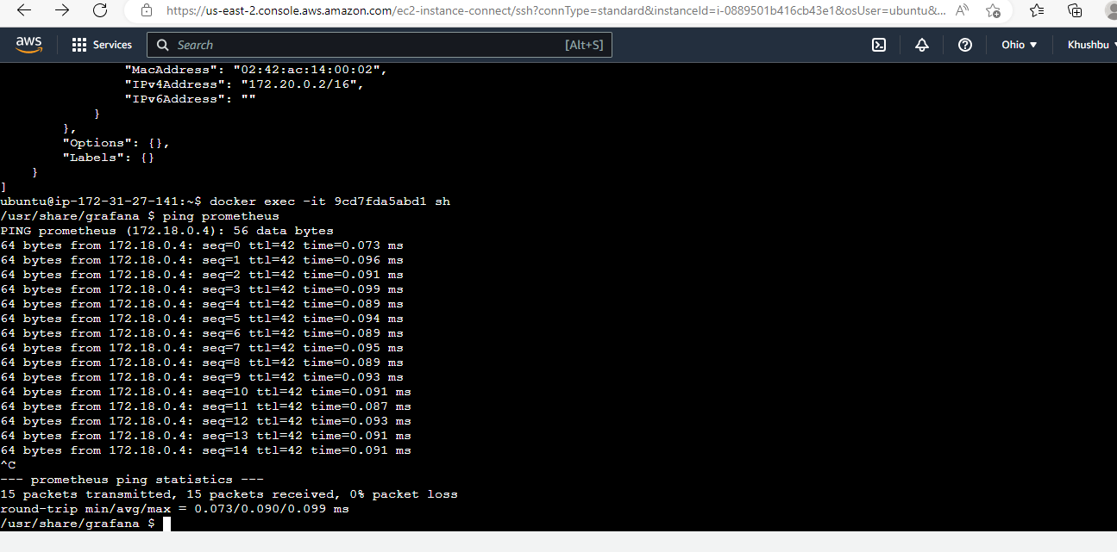
Interaction

Slide 21
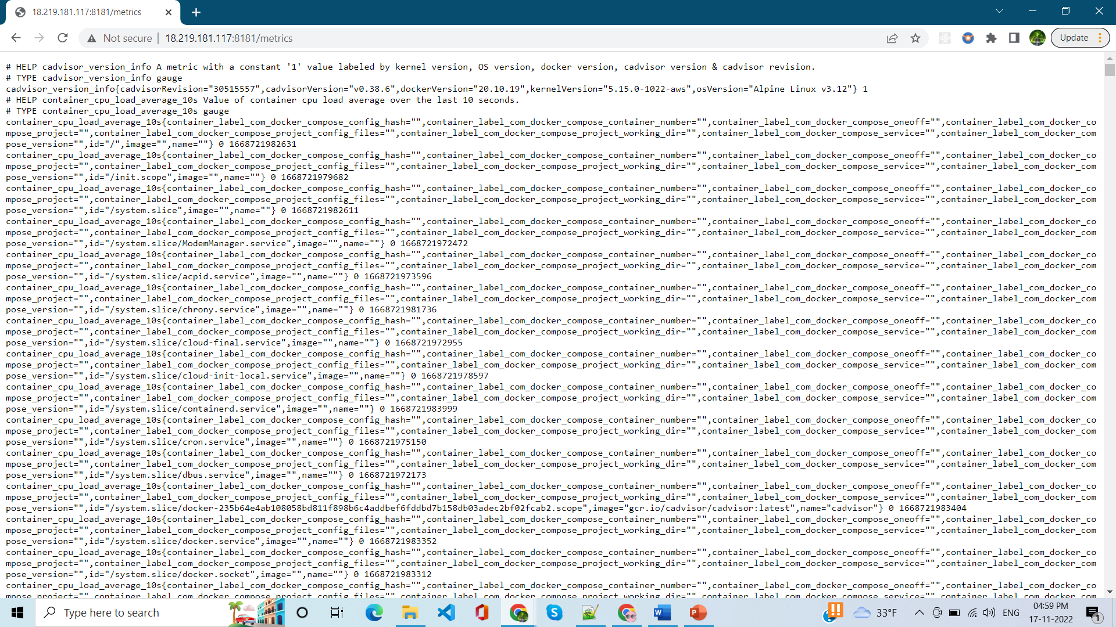
Cadvisor

Slide 22
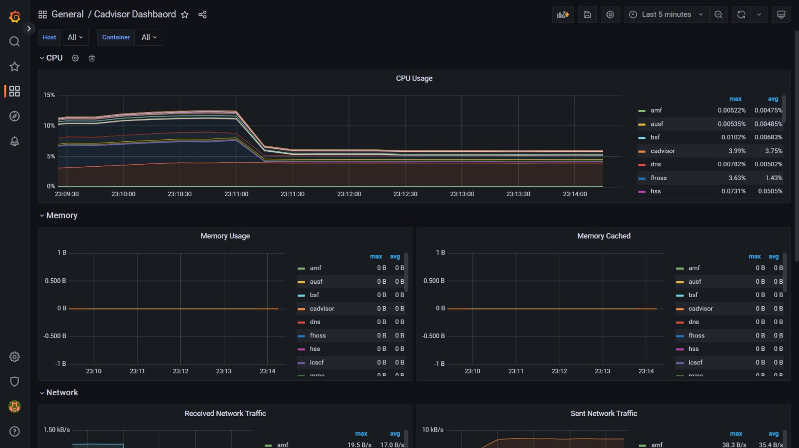
Grafana

Slide 23
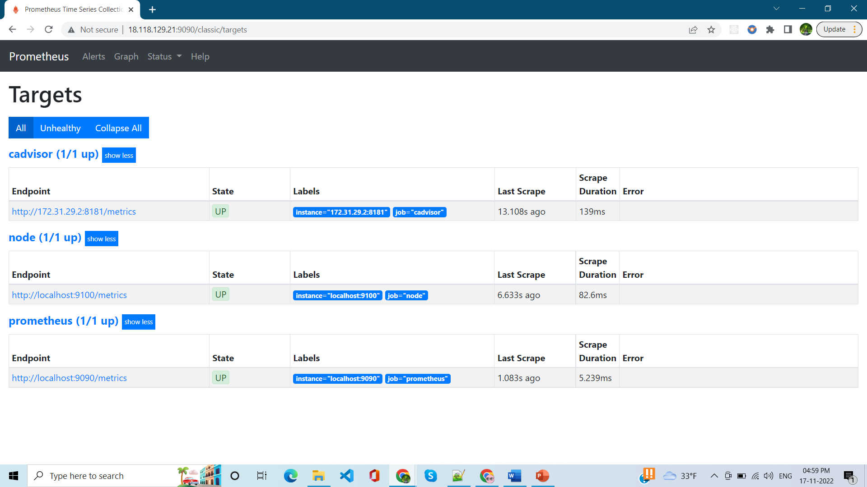
Prometheus

Slide 24
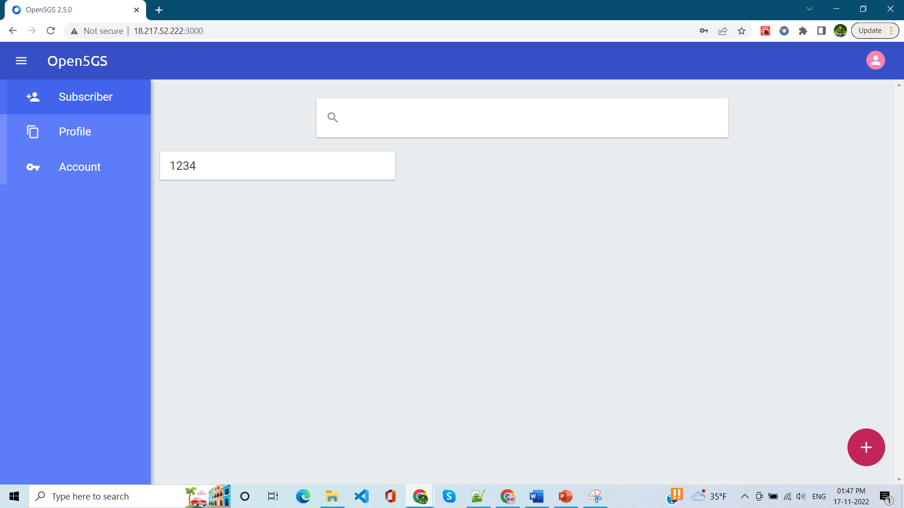
Open5g Application

Slide 25
Implementation
Demo

Slide 26
References
https://github.com/open5gs/open5gs
Nikolaos Apostolakis, Marco Gramaglia, and Pablo Serrano - Design and Validation of an Open Source Cloud Native Mobile Network
https://open5gs.org/open5gs
https://medium.com/rahasak/5g-core-network-setup-with-open5gs-and-ueransim-cd0e77025fd7
Docker Hub Account: https://hub.docker.com/u/akhilreddy62
GitHub Repo link: https://github.com/AkhilReddy62/open5gs_2

Slide 27
Thank You.
www.kent.edu

